Slide 1
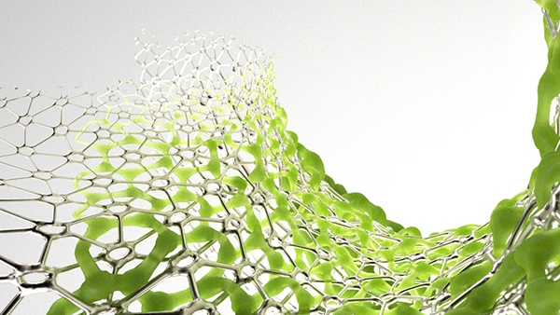
Visual Evolver
creating shapes with
generative algorithms

Slide 2
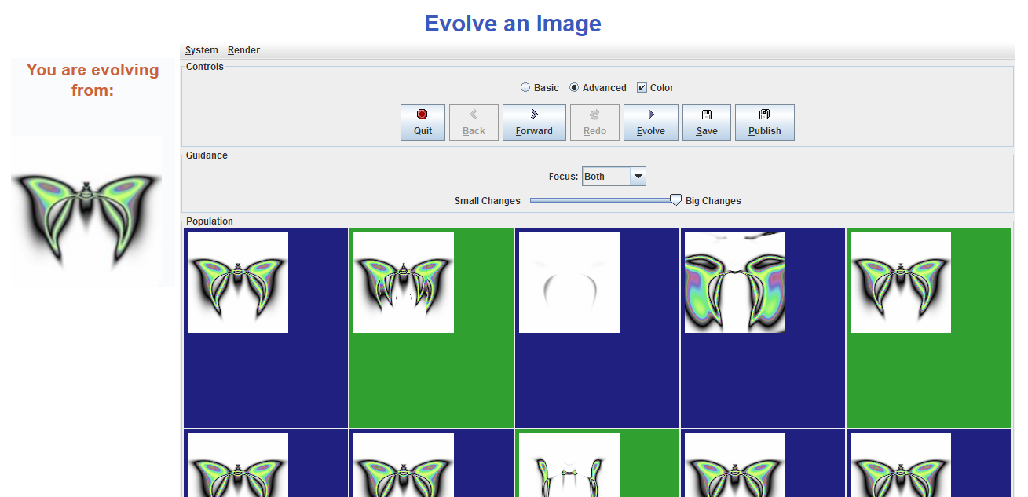
The Inspiration...
Notes:
http://PicBreeder.org

Slide 3
The Upgrades...
• Fluid experience
• Complexity abstraction
• Coolness factor
• Tangible results

Slide 4
The Idea...

Slide 5
The Idea...

Slide 6
The solution...
• Map genotype to 2D space
• Let the user navigate the space
• Provide a single instance of visual feedback
• Morph in real time

Slide 7
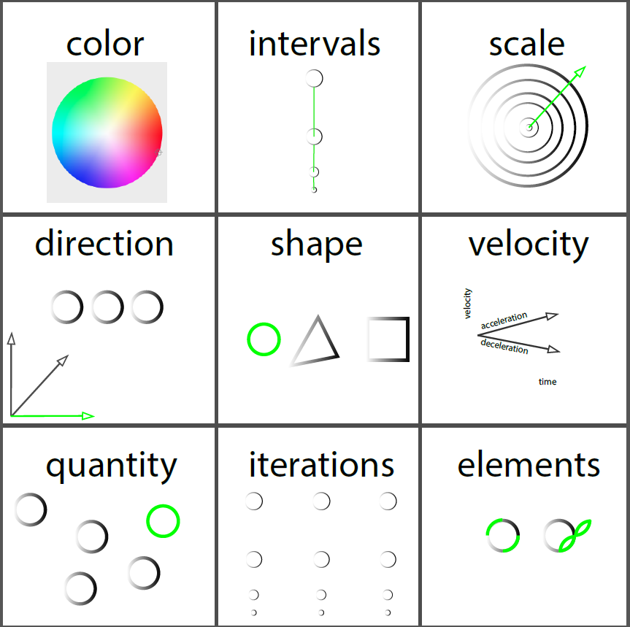
Mapping...
"By moving your fingers towards a new area in the space you navigate among new mutations provided by the system. Thus morphing could be seen in real time"

Slide 8
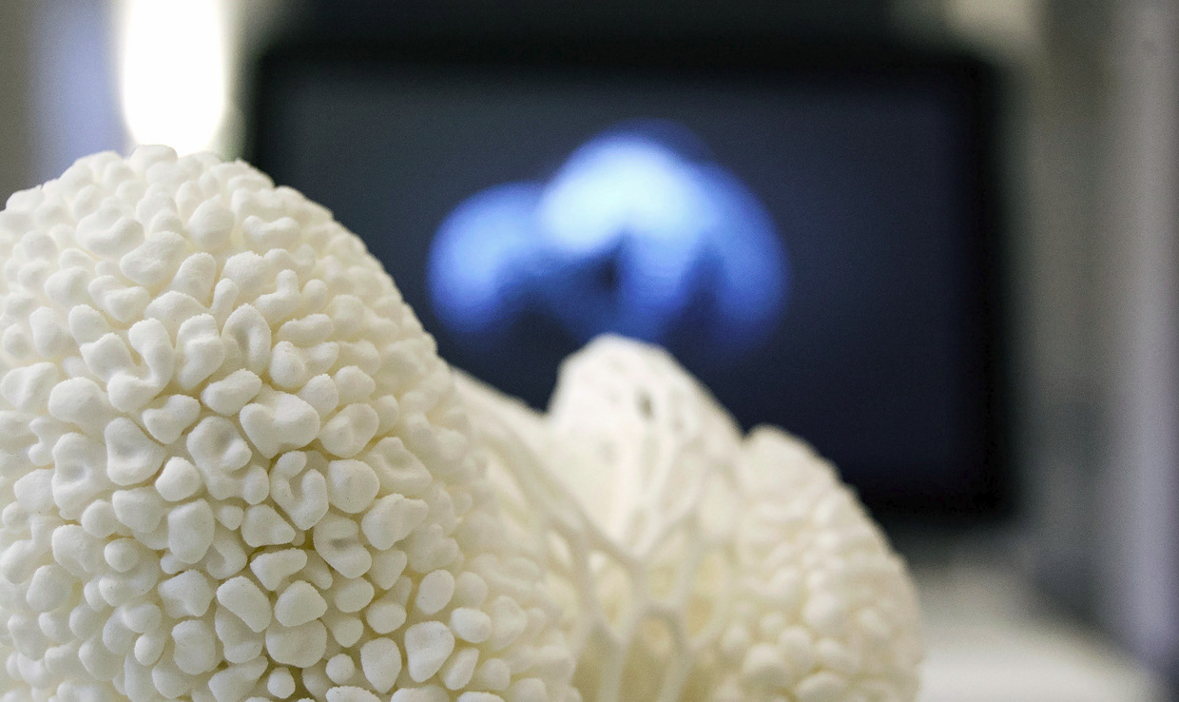
The Result...

